Slide 1
CSC 112: Computer Operating Systems Lecture XX TODO
Department of Computer Science,
Hofstra University
Acknowledgement: Lecture slides based on UC Berkeley CS 162: Operating Systems and System Programming

Slide 2

Real-Time Operating Systems M
9. Real-Time: Basic Concepts

Slide 3

Notice
The course material includes slides downloaded from: http://codex.cs.yale.edu/avi/os-book/
(slides by Silberschatz, Galvin, and Gagne, associated with Operating System Concepts, 9th Edition, Wiley, 2013)
and
http://retis.sssup.it/~giorgio/rts-MECS.html
(slides by Buttazzo, associated with Hard Real-Time Computing
Systems, 3rd Edition, Springer, 2011)
which has been edited to suit the needs of this course. The slides are authorized for personal use only.
Any other use, redistribution, and any for profit sale of the slides (in any form) requires the consent of the copyright owners.
9.2
Torroni, Real-Time Operating Systems M ©2013

Slide 4
Objectives
Study software methodologies to support time critical systems:
Study software methodologies and algorithms to increase predictability
in (embedded) computing system…
…consisting of several concurrent activities…
…subject to timing constraints
Learn how to model and analyze a real-time application to predict worst-case response times and verify its feasibility under a set of constraints

Slide 5
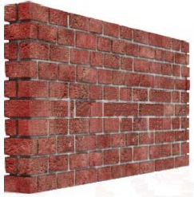



Control and Implementation
Often, control and implementation are done by different people that do not talk to each other:
Control guys typically assume a computer with infinite resources and computational power. In some case, computation is modeled by a fixed delay Δ.

Slide 6
Control and Implementation
In reality, a computer:
has limited resources
finite computational power (non null execution times)
executes several concurrent activities
introduces variable delays (often unpredictable)
Modeling such factors and taking them into account in the design phase allows a significant improvement in performance and reliability

Slide 7

Definitions
and
Sample Applications

Slide 8





Embedded System
A computing system hidden in an object to control its functions, enhance its performance, manage the available resources and simplify the interaction with the user.
Object
micro- processor
actuators
Environment
sensors
communication
user
other units

Slide 9
Control System Components
In every control application, we can distinguish 3 basic components:
The system to be controlled
may include sensors and actuators
The controller
sends signals to the system according to a predetermined control objective
The environment in which the system operates

Slide 10
A Typical Control System
System
Controller
actuators
Environ.
sensor
sensor
feedback
internal state
Sensory processing
pre- processing
external state
Other activities
filtering, classification, data fusion, recognition, planning

Slide 11
Software Vision
computer
D/A
actuators
Environ.
A/D
sensors
Thread (task)
Resource

Slide 12
Types of Control Systems
Depending on the system-environment interactions, we can distinguish among 3 types of control systems:
Monitoring systems
do not modify the environment
Open-loop control systems
loosely modify the environment
Closed-loop control systems
tight interaction between perception and action

Slide 13



Monitoring Systems
Do not modify the environment
surveillance systems, air traffic control
Real-time system
sensors
Data processing
sensors
.
.
Environ- ment
Display
sensors

Slide 14
Open-Loop Control Systems
Sensing and control are loosely coupled
Assembly robots, sorting robots
Controller
System
actuators
Environ- ment
Planning
Data processing
sensors

Slide 15
Closed-Loop Control Systems
Sensing and control are tightly coupled
Flight control systems, military systems, living beings
Controller
System
actuators
Environ- ment
Planning
Data processing
sensors

Slide 16
Implications
The tight interaction with the environment requires the system to react to events within precise timing constraints
Timing constraints are imposed by the dynamics of the environment
The operating system must be able to execute tasks within timing constraints

Slide 17





A Robot Control Example
Consider a robot equipped with:
two actuated wheels
two proximity (US) sensors
a mobile (pan/tilt) camera
a wireless transceiver
Goal:
follow a path based on visual feedback
avoid obstacles
send complete robot status every 20 ms

Slide 18
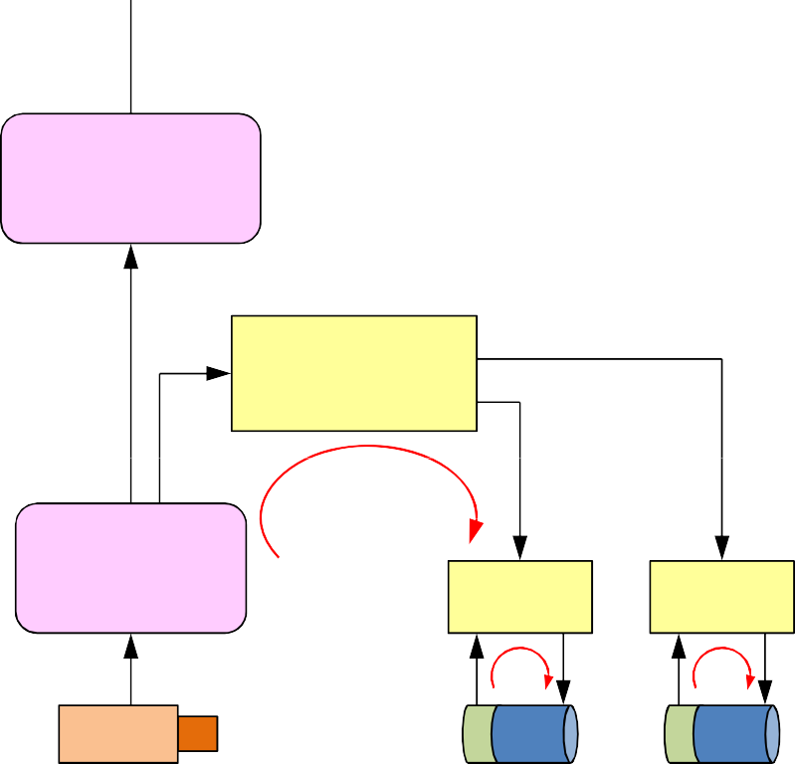
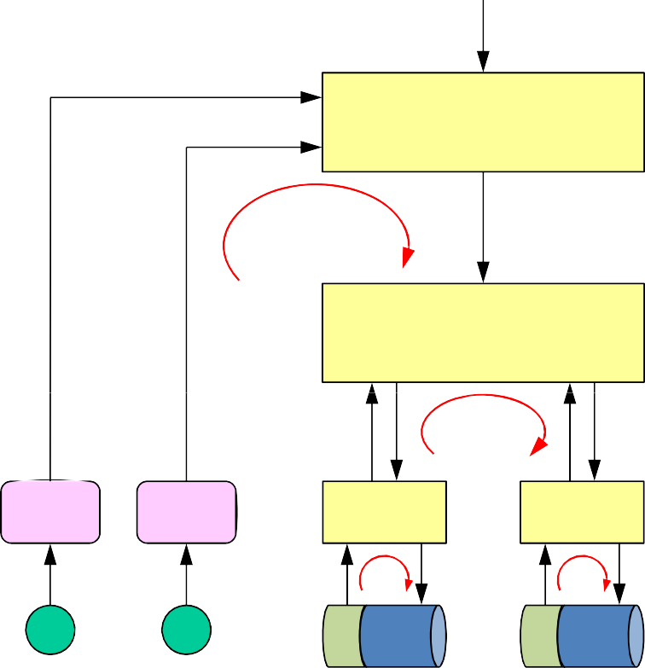
Hierarchical Control
visual−based navigation
100 ms
obstacle avoidance
object recognition
10 ms
visual tracking
vehicle control
5 ms
feature extraction
20 ms
motor control
motor control
1 ms
motor control
motor control
1 ms
camera
pan
tilt
US1 US2
mot_dx
mot_sx

Slide 19
Design Requirements
Modularity: a subsystem must be developed without knowing the details of other subsystems (team work)
Configurability: software must be adapted to different situations (through the use of suitable parameters) without changing the source code
Portability: minimize code changes when porting the system to different hardware platforms
Predictability: allow the estimation of maximum delays
Efficiency: optimize the use of available resources (computation time, memory, energy)

Slide 20
Operating System Requirements
Timeliness: results must be correct not only in their value but also in the time domain
provide kernel mechanism for time management and for handling tasks with explicit timing constraints and different criticality
Predictability: system must be analyzable to predict the consequences of any scheduling decision
if some task cannot be guaranteed within time constraints, system must notify this in advance, to handle the exception (plan alternative actions)
Efficiency: operating system should optimize the use of available resources (computation time, memory, energy)
Robustness: must be resilient to peak-load conditions
Fault tolerance: single software/hardware failures should not cause the system to crash
Maintainability: modular architecture to ensure that modifications are easy to perform

Slide 21
Modularity
Modularity can be achieved by:
partitioning the system into a set of subsystems, each managed by one or more computational tasks
the definition of precise interfaces between tasks, each specifying:
data exchanged with the other tasks (input and output)
functionality of the task (what it has to do)
validity assumptions (e.g., admissible ranges)
performance requirements (priority, period, deadline, jitter)
Asynchronous communication mechanisms

Slide 22
Control View
visual−based navigation
100 ms
obstacle avoidance
object recognition
10 ms
visual tracking
vehicle control
5 ms
feature extraction
20 ms
motor control
motor control
1 ms
motor control
motor control
1 ms
camera
pan
tilt
US1 US2
mot_dx
mot_sx

Slide 23

Software View
periodic task
buffer
visual−based navigation
obstacle avoidance
object recognition
visual tracking
vehicle control
feature extraction
motor control
camera
pan
tilt
US1 US2
mot_dx
mot_sx

Slide 24
RTOS Responsibilities
The Real-Time Operating System (RTOS) is responsible for:
managing the concurrent execution of the various activities
concurrent tasks
decide the order of execution of the tasks, satisfying the specified requirements
scheduling
solving possible timing conflicts during the access of shared resources
critical sections
manage the timely execution of asynchronous events
interrupts

Slide 25


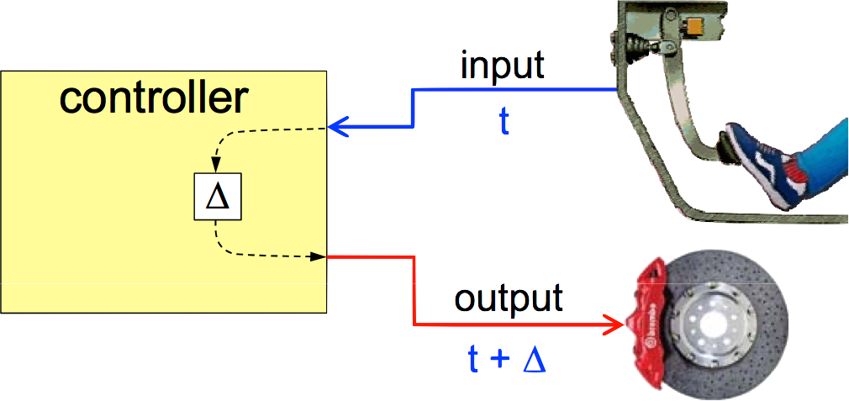
What is a Real-Time System?
A computer system able to respond to events within precise timing constraints
x (t)
RT system Environment
t
y (t+Δ)
A system where the correctness depends not only on the output values, but also on the time at which results are produced

Slide 26
Typical Objection
“It is not worth to invest in Real Time theory, because computer speed is increasing exponentially, and all timing constraints can eventually be handled.”
Answer
Given an arbitrary computer speed, we must always guarantee that timing constraints can be met. Testing is NOT sufficient

Slide 27
Real-Time ≠ Fast
A real-time system is not a fast system
Speed is always relative to a specific environment
Running faster is good, but does not guarantee a correct behaviour.
The objective of a real-time system is to guarantee the timing behaviour of each individual task
The objective of a fast system is to minimize the average response time of a task set. But…
Don’t trust average when you have to guarantee individual
performance

Slide 28
Sources of Nondeterminism
Architecture
cache, pipelining, interrupts, DMA
Operating System
scheduling, synchronization, communication
Language
lack of explicit support for time
Design Methodologies
lack of analysis and verification techniques

Slide 29
Design Methodologies
Traditional approach: empirical techniques
assembly programming
timing through dedicated timers
control through driver programming
priority manipulations
Many disadvantages!
tedious programming, heavily relies on programmer’s ability
difficult code understanding (readability × efficiency = k)
difficult software maintainability
 MLOC, understanding takes more than rewriting => bug prone
difficult to verify timing constraints without OS & language support

Slide 30
Implications
Dangerous way of programming real-time applications
May work in most situations, but high risk of failure
When the system fails, it is very difficult to understand why
Low reliability
Many famous failures
First flight of the Space Shuttle, 1979 (transient overload at initialization)
probability of failure ~1.5%
Scud missile on Dhahran, 1993 (delay due to interrupt handling)
program flow depends on sensory data, cannot be fully replicated
testing is not enough
Ariane 5, 1996 (integer overflow in inertial reference system routine)
Environment
Mars Pathfinder, 1997 (priority inversion, see Silberschatz)

Slide 31
Take-Home Message
Tests, although necessary, allow only a partial verificaiton of system’s behaviour
Predictability must be improved at the kernel level
Overload handling and fault-tolerance
Critical systems must be designed by making pessimistic assumptions…
…Murphy’s laws
If something can go wrong, it will go wrong
If a system stops working, it will do it at the worst possible time
Sooner or later, the worst possible combination of circumstances will happen…

Slide 32
Achieving predictability
DMA
Cycle stealing
Possible solution: time-slice method
each memory cycle split into two adjacent time slots
one reserved for the CPU, the other for the DMA device
more expensive than cycle stealing
but more predictable

Slide 33
Achieving predictability
Cache
Hit ratio
80% of times: hits
20% of times: performance degrades
Preemptive systems destroy locality
Cache-related preemption delay difficult to precisely estimate

Slide 34
Achieving predictability
Interrupts
Source: peripheral devices
Can introduce unbounded delays
Handling routines with static priorities
generic OS: I/O have real-time constraints
RTOS: a control process could be more urgent than interrupt handling
3 different approaches

Slide 35
Achieving predictability
Interrupts
Can introduce unbounded delays
Disable all interrupts, except the one from the timer; devices handled by application tasks using polling
● + predictability, kernel-independent; - efficiency
Disable all interrupts except the one from the timer; manage devices via periodic kernel routines
● + encapsulation; - overhead
Leave all interrupts enabled; minimize drivers’ size (only activates device management task)
● + no busy waiting; - (small) unbounded overhead due to drivers

Slide 36
Achieving predictability
System Calls
Could be difficult to evaluate worst-case execution time of each task
All system calls should be characterized by bounded execution time
Desirable that system calls be preemptable

Slide 37
Achieving predictability
Semaphores
Priority inversion
Must be avoided!
Several methods:
Basic priority inheritance
Priority ceiling

Slide 38
Achieving predictability
Memory management
Demand paging
Solution: static partitioning
memory segmentation rule with fixed memory management scheme
■ + predictability, - flexibility in dynamic environments

Slide 39
Achieving predictability
Programming language
Dynamic data structures
Recursion
Cycles
High-level languages for programming hard real-time applications
Real-Time Euclid
Real-Time Concurrent C

Slide 40
Modeling
Real-Time Activities

Slide 41




Task
Sequence of instructions that in the absence of other activities is continuously executed by the processor until completion.
activation time
Task τ_{i}
C_{i}
start time
a_{i} s_{i} f_{i}
R_{i}
The interval f_{i} − a_{i} is referred to as the task response time R_{i}
t
computation
time
finishing time
activation
Ready queue
τ₃ τ₂ τ₁
dispatching termination
CPU
 Note: “activation” = “arrival” = “request” = “release” time

Slide 42
Schedule
A particular assignment of tasks to the processor that determines the task execution sequence. Formally:
Given a task set Γ={ τ₁, …, τ_{n} }, a schedule is a function σ: R⁺ → N that associates an integer k to each time slice [t_{i}, t_{i+1}) with the meaning:
k=0: in [t_{i}, t_{i+1}) the processor is idle
k>0: in [t_{i}, t_{i+1}) the processor executes τ_{k}
idle
τ₁ τ₂ τ₃
idle
σ(t)
3
2
1
0
t₁ t₂
t₃
t₄
t
At times t₁, t₂,…: context switch

Slide 43
Preemptive Scheduling
A running tasks may be suspended and placed in the ready queue
● + Exception handling: timely response to issues
● + Different levels of criticality: preemption executes most critical tasks
● + Higher efficiency (CPU utilization)
- Destroys program locality
- Introduces runtime overhead
priority
τ₁
τ₂
τ₃
0
2
4
6
8 10 12 14 16 18 20
σ(t)
3
2
1
0
0
2
4
6
8 10 12 14 16 18 20

Slide 44
Definitions
Definition: feasible schedule
A schedule σ is said to be feasible if all the tasks can complete according to a set of specified constraints.
Definition: schedulable set of tasks
A set of tasks Γ is said to be schedulable if there exists at least one
algorithm that can produce a feasible schedule for it.

Slide 45

Real-Time Task
It is a task characterized by a timing constraint on its response time, called
deadline:
relative deadline D_{i}
τ_{i}
a_{i} s_{i}
response time R_{i}
f_{i}
t
d
i
absolute deadline (d_{i} = a_{i} + R_{i})
“Completion time” = f_{i} - s_{i} = R_{i} – (s_{i}- a_{i})
Definition: feasible task
A real-time task τ_{i} is said to be feasible if it completes within its absolute deadline, that is, if f_{i} ≤ d_{i}, or, equivalently, if R_{i} ≤ D_{i}.

Slide 46
Slack and Lateness
D_{i}
τ_{i}
a_{i}
s_{i}
f_{i}
d_{i}
slack_{i} = d_{i} - f_{i}
t
R_{i}
D_{i}
lateness
L_{i} = f_{i} - d_{i}
τ_{i}
ªi ^{s}i
d_{i} f_{i}
t
R_{i}
“Slack” if lateness is negative (task completes before deadline)
“Laxity” or “slack time” X_{i} = d_{i} – a_{i} – C_{i}
“Tardiness” or “exceeding time” E_{i} = max( 0, L_{i} )

Slide 47
Tasks and Jobs
A task running several times on different input data generates a sequence of instances (jobs):
Job 1
τi,1
Job 2
τi,2
Job 3
τi,3
Ci
τi
ai,1
ai,k
ai,k+1
t

Slide 48
Activation Mode
Time-driven
Periodic tasks (τ_{i})
The task is automatically activated by the operating system at predefined time instants.
Event-driven
Aperiodic tasks: “jobs” (J_{i})
The task is activated at an event arrival or by explicitly invocating a system call.

Slide 49



Periodic Task
input
₌ C_{i}
U
i
T_{i}
C
i
computation time
output
utilization factor
sync
timer (period T_{i} )
A periodic task τ_{i} generates an infinite sequence of instances or jobs
(same code on different data): τ_{i,1}, τ_{i,2}, …, τ_{i,k}, …
T_{i}
C_{i}
τ_{i}

Slide 50




The IDLE State
signal
BLOCKED
wait
activate
dispatching
terminate
READY
RUNNING
preemption
wake_up
wait_for_next_period
IDLE
Timer

Slide 51
Periodic Task
τi (Ci , Ti , Di )
Ci
Ti
job τik
ai,1 = Φi
ai,k
ai,k+1
t
task phase
ai,k di,k
= Φi + (k−1) T_{i}
= a_{i,k} + D_{i}
often
Di = Ti

Slide 52
Exercise
Consider a periodic task τ₁(C₁,T₁,D₁) with phase Φ₁, where:
C₁ = 10 ms, T₁ = 50 ms, D₁ = 25 ms, and Φ₁ = 100 ms
What is τ₁’s utilization factor?
Is τ₁ feasible?
What is τ_{1,1}’s absolute deadline?
What is τ_{1,1}’s laxity?
What is τ_{1,2}’s release time?
Can τ_{1,1} and τ_{1,2} have different laxity?
Can τ_{1,1} and τ_{1,2} have different slack?
If τ_{1,2}’s slack is 10ms, what is τ_{1,s}’s finishing time?
What is τ_{1,2}’s response time?
With a 2-CPU machine, can τ_{1,2} and τ_{1,3} have the same release time?
Can τ_{1,2} and τ_{1,3} have the same finishing time?
9.51
Torroni, Real-Time Operating Systems M ©2013

Slide 53

Aperiodic Task
Aperiodic:
ai,k+1 > ai,k
minimum interarrival time
Sporadic:
ai,k+1
≥ a_{i,k} + T_{i}
job τik
τi
Ci
Ci
Ci
ai,1
ai,k
ai,k+1
t

Slide 54


Estimating C_{i} is Not Easy
Each job operates on different data and can take different paths.
Even for the same data, computation time
?
depends on the processor state (cache, prefetch queue, number of preemptions).
loop
?
# occurrencies
?
execution time
timer
min
max
C_{i}
C_{i}

Slide 55
Predictability vs. Efficiency
# occurrencies
execution time
C_{i}
min
C_{i}
avg
C_{i}
max
C_{i} estimate
unsafe
efficient
safe

Slide 56
Predictability vs. Efficiency
non-RT task SOFT task HARD task
efficiency predictability
C_{i}
C_{i}
min
C_{i}
avg
C_{i}
max

Slide 57
Criticality and Value
It is a parameter related to the consequences of missing the deadline
Hard: missing deadline may have catastrophic consequences
Hard Real-Time System if it can handle hard tasks
sensory acquisition
low-level control
sensory-motor planning
Soft: missing a deadline causes performance degradation
reading data from the keyboard—user command interpretation
message displaying
graphical activities
Value, v_{i} = the relative importance of a task wrt other tasks

Slide 58
Jitter
It is a measure of the time variation of a periodic event:
a1 t1
a2
t2 a3 t3
a4
Absolute:
max (t_{k} – a_{k}) – min (t_{k} – a_{k})
k k
max | (t_{k} – a_{k}) – (f_{k-1} – a_{k-1}) |
Relative:
k

Slide 59
Types of Jitter
Finishing-time Jitter
τ_{i}
fi,1
fi,2
fi,3
Start-time Jitter
τ_{i}
si,1 si,2 si,3
Completion-time Jitter (I/O Jitter)
τ_{i}
si,1
fi,1
si,2
fi,2
si,3
fi,3

Slide 60
Task Constraints

Slide 61
Types of Constraints
Timing constraints
Activation, completion, jitter.
Precedence constraints
They impose an ordering in the execution.
Resource constraints
They enforce a synchronization in the access of mutually exclusive resources.

Slide 62
Explicit Timing Constraints
Timing constraints can be explicit or implicit.
Explicit timing constraints
Directly included in the system specifications.
Example:
open the valve in 10 seconds
send the position within 40 ms
read the altimeter every 200 ms
acquire the camera every 20 ms

Slide 63
Implicit Timing Constraints
They do not appear in the system specifications…
but need to be met in order to satisfy the performance requirements
Example
What is the validity of a sensory data?
t₀
?

Slide 64
Computing the Yellow Duration
STOP
D ≥ T_{d} + T_{r} + T_{b}
T_{d} = Detection time
T_{r} = Reaction time
T_{b} = Braking time ~ v / .5 g
T_{d} = .8s, T_{r} = .8s, v = 50 km/h (14 m/s) → D ≥ ???
v_{max}???

Slide 65
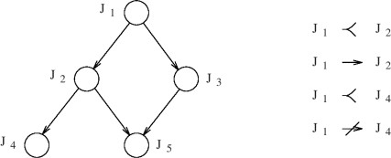
Precedence Constraints
Sometimes tasks must be executed with specific precedence relations, specified by a Directed Acyclic Graph (Precedence Graph):
Immediate predecessor
Predecessor

Slide 66



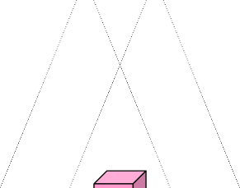




Sample Application
stereo vision
processing
recognition
Tasks:
Acquisition (acq1, acq2)
Edge detection (edge1, edge2)
Shape detection (shape), pixel disparities (disp)
Height determination (height), recognition (rec)
Precedence graph?

Slide 67






Precedence Graph
acq1
acq2
edge1
edge2
disp
shape
depth
rec

Slide 68
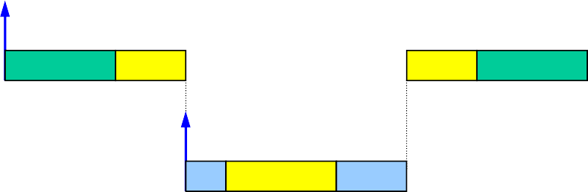
Resource Constraints
To preserve data consistency, shared resources must be accessed in
mutual exclusion:
τ_{W}
x = 3
y = 5
τ_{R}
x = 1
y = 8
x = 1
y = 5
τ_{W}
τ_{R}
x=1
y=8
read

Slide 69
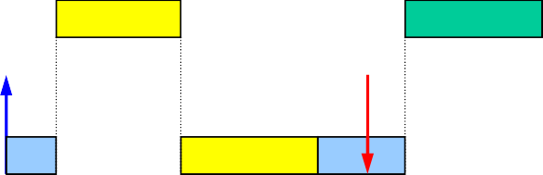
Mutual Exclusion
However, mutual exclusion introduces extra delays:
τ_{W}
x = 3
y = 5
τ_{R}
x = 1
y = 8
x = 1
y = 8
τ_{W}
x = 1
y = 8
τ_{R}
read
Δ

Slide 70
Definition of Scheduling Problems

Slide 71
General Scheduling Problem
Given:
a set of n tasks, Γ = {τ₁, τ₂, …, τ_{n}}
a precedence graph
a set of timing constraints associated with each task
a set of m processors, P = {P₁, P₂, …, P_{m}}
a set of s types of resources, R = {R₁, R₂, …, R_{s}}
find an assignment of P and R to Γ which produces a feasible schedule.
Γ P R
Scheduling algorithm
σ
feasible

Slide 72
Scheduling Complexity
In 1975, Garey and Johnson showed that the general scheduling problem is NP hard.
There is no known polinomial time algorithm
Meaning:
Consider n = 30 tasks; elementary step = 1μs
Alg. 1: O(n)
Alg. 2: O(n⁶)
Alg. 3: O(6^{n})
Computation time?
However, polynomial time algorithms can be found under particular conditions

Slide 73
Simplifying Assumptions
Simplify architecture
Single processor
Homogeneous task sets
Only periodic / only aperiodic
Fully preemptive tasks
Simultaneous activations
No precedence constraints
No resource constraints
…
Different classes of algorithms

Slide 74
Algorithm Tassonomy
Preemptive vs. Non Preemptive
Static vs. Dynamic
On-line vs. Off-line
Optimal vs. Heuristic
Guaranteed vs. Best-effort
Clairvoyant algorithm

Slide 75
Static vs Dynamic
Static scheduling algorithms
scheduling decisions are taken based on fixed parameters, statically assigned to tasks before activation.
Dynamic scheduling algorithms
scheduling decisions are taken based on parameters that can change with time.

Slide 76
Off-line vs. On-line
Off-line scheduling algorithms
all scheduling decisions are taken before task activation: the schedule is stored in a table and later executed by a dispatcher
“table-driven scheduling”
On-line scheduling algorithms
scheduling decisions are taken at run-time on the set of active tasks
When?

Slide 77
Optimal vs. Heuristic
Optimal scheduling algorithms
They generate a schedule that minimizes a cost function, defined based on an optimality criterion.
Heuristic scheduling algorithms
They generate a schedule according to a heuristic function that tries to satisfy an optimality criterion, but there is no guarantee of success.

Slide 78
Guaranteed vs. Best Effort
Guaranteed scheduling algorithms
They generate a feasible schedule if there exists one
Needed is hard real-time
Pessimistic assumptions
Best effort scheduling algorithms
No guarantee of a feasible schedule.
Useful if soft real-time
Optimize average performance

Slide 79
Guarantee-Based Algorithms
In hard real-time applications, the feasibility of the schedule must be guaranteed before task execution
Give the system time to try and avoid catastrophic consequences
Look-ahead and worst-case reasoning
Static real-time systems: guarantee off-line; table-based scheduling
● + Run-time overhead does not depend on complexity of scheduling algorihtm
- Flexibility
Dynamic real-time systems: task can be created at run-time
Guarantee online every time a new task is created

Slide 80






Guarantee Mechanism
BLOCKED
signal
wait
dispatching
activation
YES
termination
acceptance test
READY
RUNNING
preemption
NO
ACTIVE
Worst-case assumption: a task could unnecessarily be rejected
- Efficiency
Early detection of potential overload situation
● + Avoid negative effects (possible catastrophe, domino effect)

Slide 81
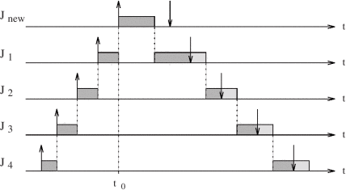
Domino Effect

Slide 82
Metrics for Performance Evaluation
Classical operating systems
Optimality: min cost function
Average response time
Total completion time
Weighted sum of completion times
Maximum lateness
Maximum number of late tasks
…
Real-Time Operating Systems: these cost functions are not necessarily of interest
No individual assessment of timing properties (periods, deadlines)
Maximum lateness has no direct relation with number of tasks that miss their deadline

Slide 83
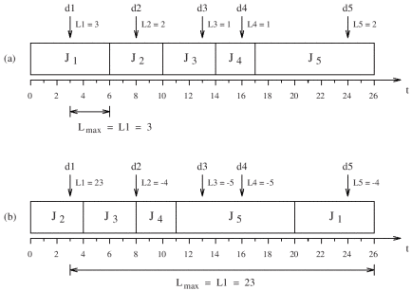
Maximum Lateness
Min maximum lateness
Min number of tasks that miss their deadline

Slide 84
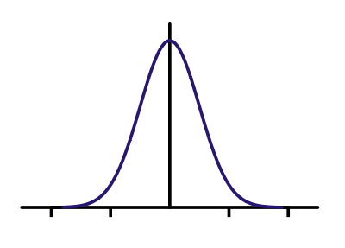
Cumulative Value
Sum of the utility functions computed at each completion time
non real-time soft real-time
on-time
v (f_{i})
v (f_{i})
a_{i}
f_{i}
a_{i}
d_{i}
f
i
hard real-time
v (f_{i})
v (f_{i})
a_{i}
d_{i}
f_{i}
a_{i} d_{i}
-∞
“better never than late”
f_{i}
“firm”

Slide 85
Scheduling Anomalies

Slide 86
A Surprising Result…
Theorem (Graham, 1976)
If a task set is optimally scheduled on a multiprocessor with some priority assignment, a fixed number of processors, fixed execution times, and precedence constraints, then increasing the number of processors, reducing execution times, or weakening the precedence constraints can increase the schedule length
Brittleness of scheduling algorithms: small changes can have big, unexpected consequences

Slide 87
Richard’s Anomalies (Graham, 1976)
T1: 3
T2: 2
T9: 9
T8: 4
priority
T3: 2
T4: 2
T7: 4
T6: 4
T5: 4
Pi > Pj ∀ i < j
Assume a parallel machine with 3 CPU. All tasks arrive at the same time.
What priority-based schedule?
How to improve schedule length?

Slide 88
1) Increase number of CPUs
T1: 3
T2: 2
T9: 9
T8: 4
priority
T3: 2
T4: 2
T7: 4
T6: 4
T5: 4
Pi > Pj ∀ i < j
Assume 4 CPUs

Slide 89
2) Reduce computation time
T1: 3
T2: 2
T9: 9
T8: 4
priority
T3: 2
T4: 2
T7: 4
T6: 4
T5: 4
Pi > Pj ∀ i < j
Reduce computation time of each task by 1 unit

Slide 90
3) Weaken precedence constraints
T1: 3
T2: 2
T9: 9
T8: 4
priority
T3: 2
T4: 2
T7: 4
T6: 4
T5: 4
Pi > Pj ∀ i < j
Remove constraints on T₇ and T₈

Slide 91
Another Surprising Result…
If tasks share mutually exclusive resources, or are non-preemptive, scheduling anomalies may also occur in uniprocessor systems
Theorem (Buttazzo, 2006)
A real time application that is feasible on a given processor can become infeasible when running on a faster processor
τ₁
τ₂
What if double the processor’s speed?

Slide 92
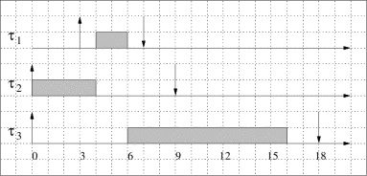
Another Surprising Result…
If tasks share mutually exclusive resources, or are non-preemptible, scheduling anomalies may also occur in uniprocessor systems
Theorem (Buttazzo, 2006)
A real time application that is feasible on a given processor can become infeasible when running on a faster processor
What if double the processor’s speed?

Slide 93
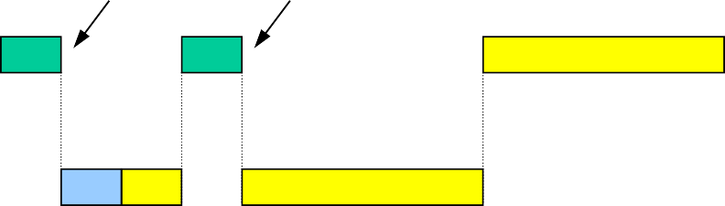
A dangerous operation: DELAY
A delay(Δ) may introduce a delay greater than Δ
τ₁
τ₂
0
2 4
delay(2)
6
blocked
8
10
12
14
τ₁
τ₂
0
2
4
6
8
10
12
14

Slide 94
A dangerous operation: DELAY
A delay(Δ) may also increase the response times of other tasks
Example for fixed priorities
τ₁
τ₂
0
4
8
12
0
5
delay(1)
10
15
deadline miss
τ₁
τ₂
0
4
8
12
0
5
10
15
1

Slide 95
A dangerous operation: DELAY
A delay(Δ) may also increase the response times of other tasks
Example for deadline scheduling
τ₁
τ₂
16
0
4
8
12
15
τ₁
τ₂
deadline miss
delay(8)
16
0
4
8
12
15

Slide 96
Take-Home Message
Tests are not enough for real-time systems
Intuitive solutions do not always work
Delay should not be used in real-time tasks
The safest approach:
Use predictable kernel mechanisms
Analyze the system to predict the behaviour
The operating system is the part most responsible for a predictable behavior. Concurrency control must be enforced by:
appropriate scheduling algorithms
appropriate syncronization protocols
efficient communication mechanisms
predictable interrupt handling

